Slide 1
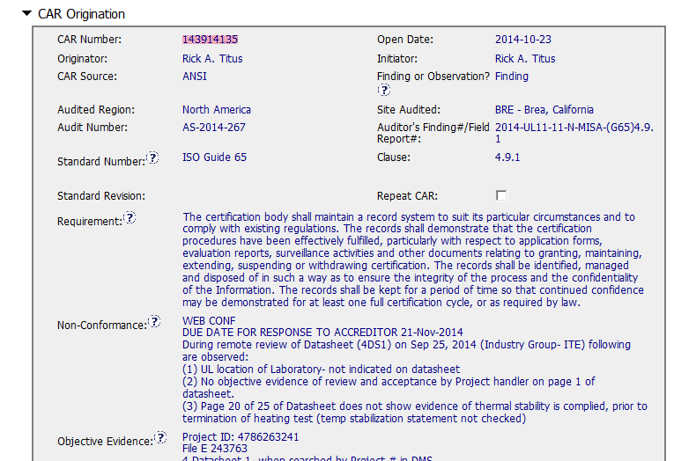
CAR 143914135

Slide 2
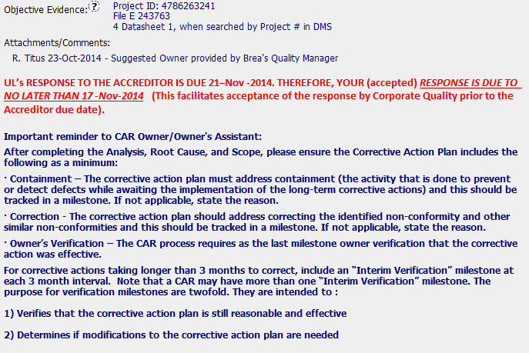
CAR 143914135
Excellent addition!!

Slide 3
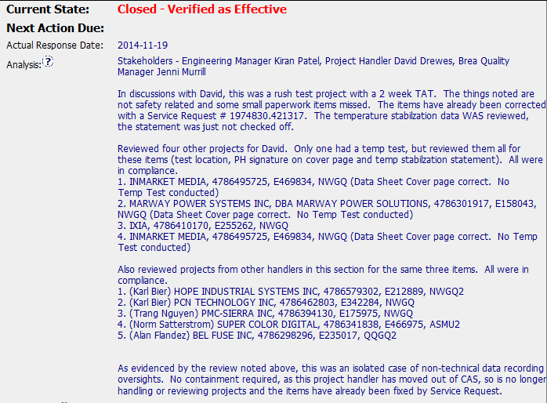
CAR 143914135
Stakeholders identified
Good sample size to conduct an investigation in other projects and other PHs.
No evidence that lab location problem was verified in other samples/same handler.
3 errors in only 1 DS does not support to conclude that the issue is isolated.
Other RUSH projects were revised?
Last sentence is guiding to human error. Why the overshight happened?

Slide 4
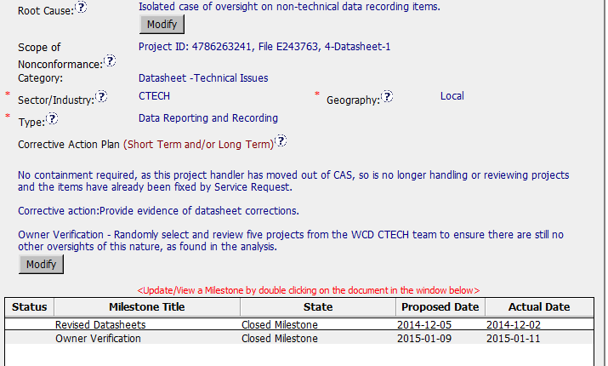
CAR 143914135
Root cause NOT IDENTIFIED
Without support for issolated issue, scope is not supported
OK in accordance with analysis provided, but not for repeated issue
Milestone:
Objective evidence was included
Verification milestone included

Slide 5
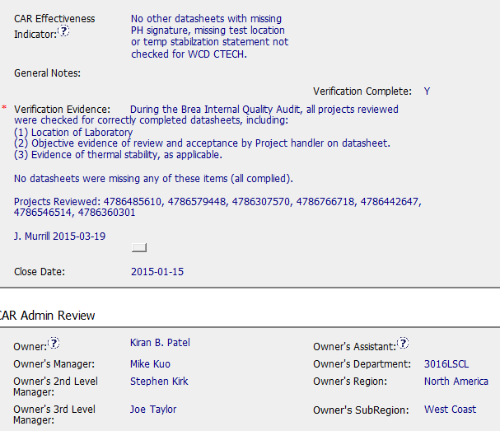
CAR 143914135
Evidence clear and complete!!

Slide 6
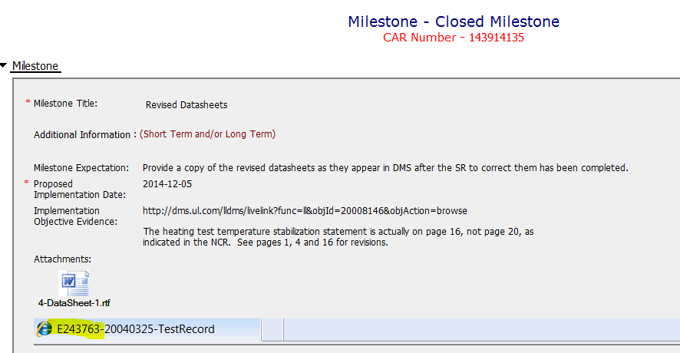
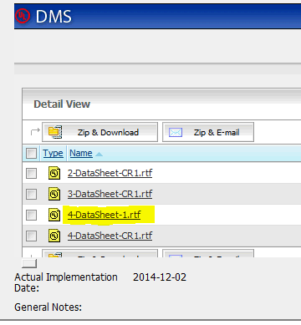
CAR 143914135
OK!! All evidence attached as milestone expectation requires.

Slide 7
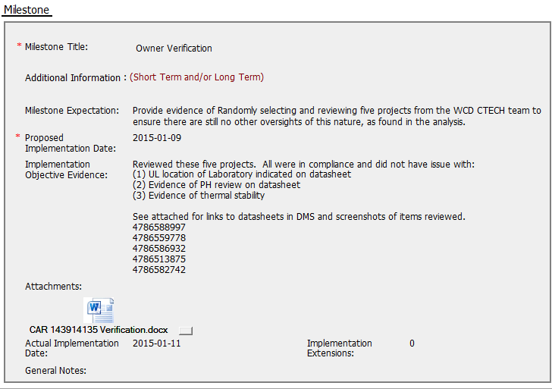
CAR 143914135
Each milestone submitted was revised within the less than 7 days.
All evidence attached as milestone expectation requires.

Slide 8



CAR 143914135
INTEGRITY
Initiative & Decision Making Analyzing & Problem Solving | Facilitates progression of the CAR through closure: extensions, escalations, reassignments, etc. Accurately completes the administrative fields within the CAR such as root cause category, process impacted, geography, etc. Acts on CARs within the required timeframe Facilitates the handling of disputed CARs NA (C) Extensions are within requirement (<30 days, 3 or less) (T) Most appropriate ‘category’, ‘type’, ‘geography’ are selected (P) Facilitates the handling of disputed CARs (T) Acts on CARs within required timeframe
COMPETITIVENESS
Customer Focus Achieve Business Results Flexibility | Assists customers as they address all aspects of the CAR – analysis, root cause statement, milestone, containment, verification, etc. Verifies CARs timely (C) Analysis shows clear path to root cause and scope; stakeholders identified (C) Root cause statement is succinct, reasonable, complete (Shows ‘N/A’ for observations) (C) Corrective actions fix the objective evidence and other problems found; address entire root cause and scope. For observations, they do not go beyond fixing the objective evidence (C) Milestones address containment & owner’s verification; completed per milestone expectations (P) Verification per requirements
COLLABORATION
Leading & Engaging Teamwork Communication | Provides pertinent feedback at appropriate times; shares information and keeps others informed Supports other CAR Champions by serving as their backup when they are absent Works as a team player with other CAR Champions (L) Referenced communications are attached as needed (C L) Evidence of communication for overdue/escalated CARs and other pertinent concerns (P) Trains other CAR Champions
CL

Slide 9
THANK YOU.

Slide 10
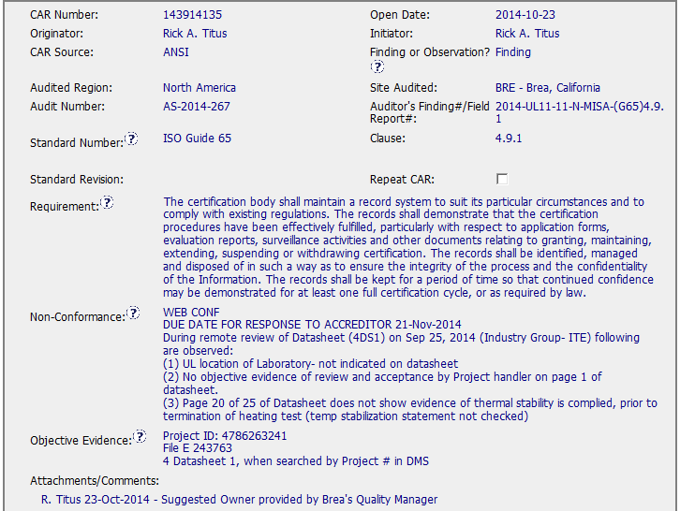
CAR 143914135 - Finding
Clear description of requirement, non-conformance and objective evidence

Slide 11
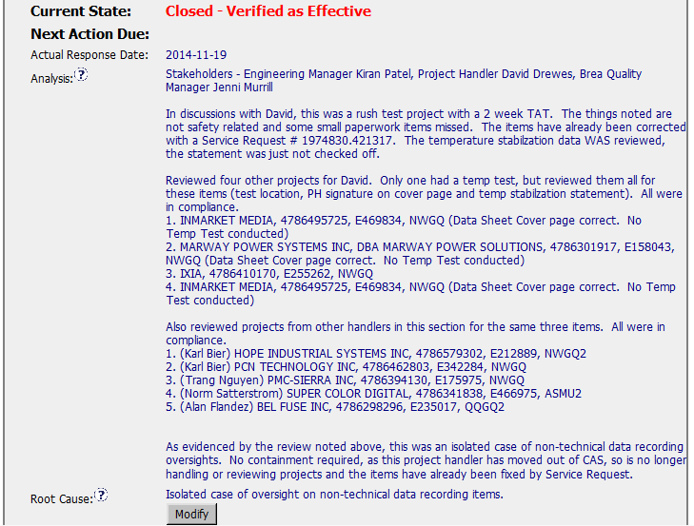
CAR 143914135 - Finding
Clearly identified stakeholders
It is reasonable to provide the listing of projects that have been reviewed to get a conclusion that it was indeed a one-time oversight.
[Competitiveness] (C) – Analysis shows clear path to root cause and scope and stakeholders identified.
[Competitiveness( (C) - Root cause statement is succinct, reasonable, complete.

Slide 12
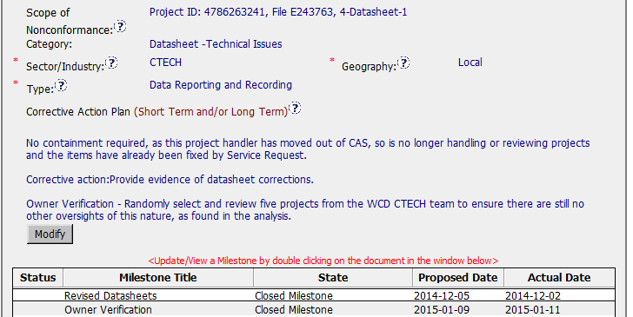
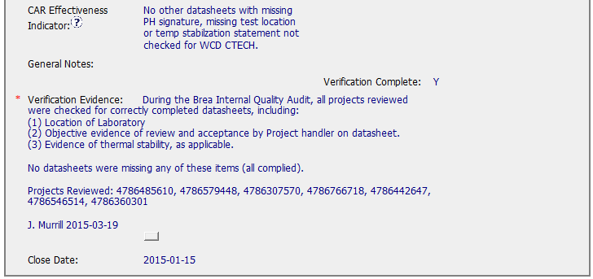
CAR 143914135 - Finding
Though from Analysis, the issue is a isolated case of oversight, but corrective actions need to be taken to prevent the problem from recurring
Corrective action should write the action detail, here it can be open a SR to correct DS issue , the sentence “Provide evidence of datasheet corrections” should be the milestone expectation.
[Integrity] (T) – Most appropriate ‘category’, ‘type’, ‘geography’ are selected.
[Competitiveness] (C) – Verification per requirements.

Slide 13
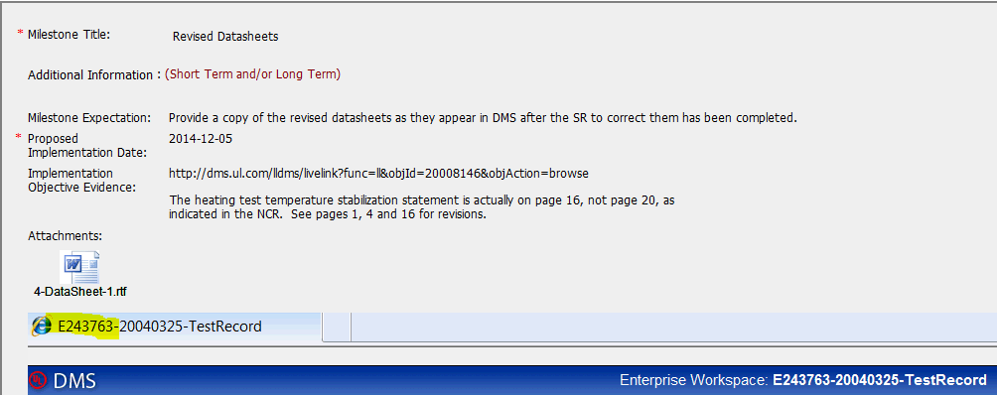
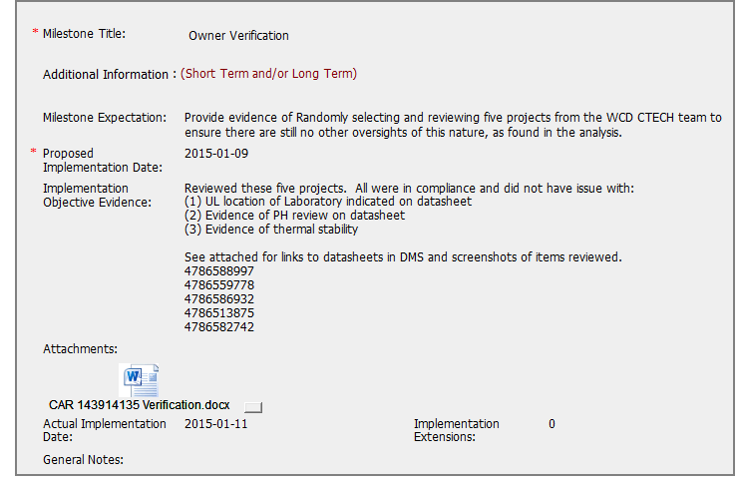
CAR 143914135 - Milestone
Corrective and verification action have been done with clear implementation objective evidences.
2 days overdue of owner verification implementation.

Slide 14
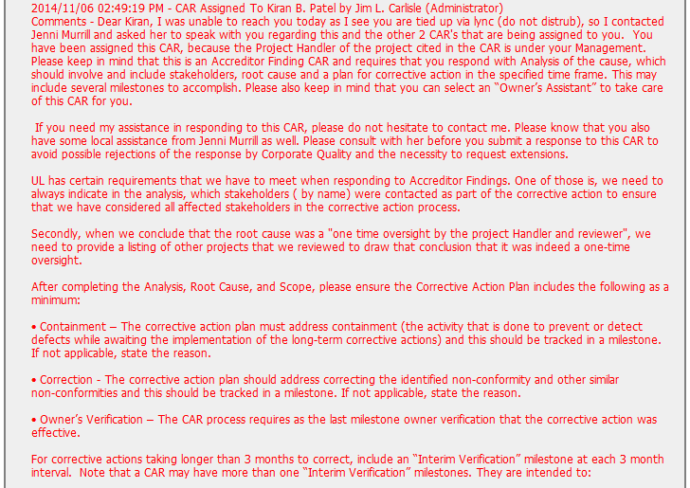
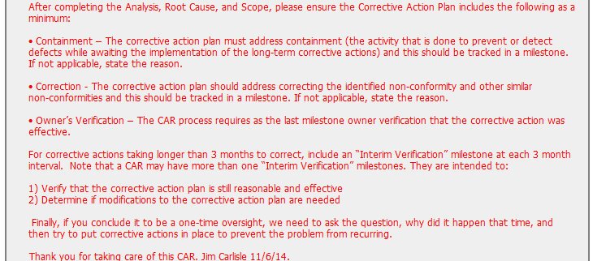
CAR 143914135 – History Study
Good practice: a very detail guidance to CAR owner

Slide 15
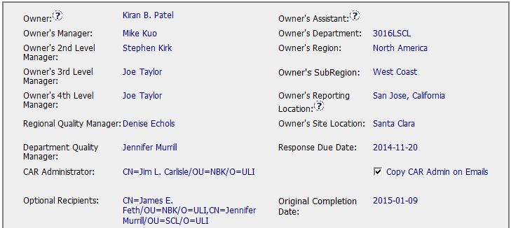
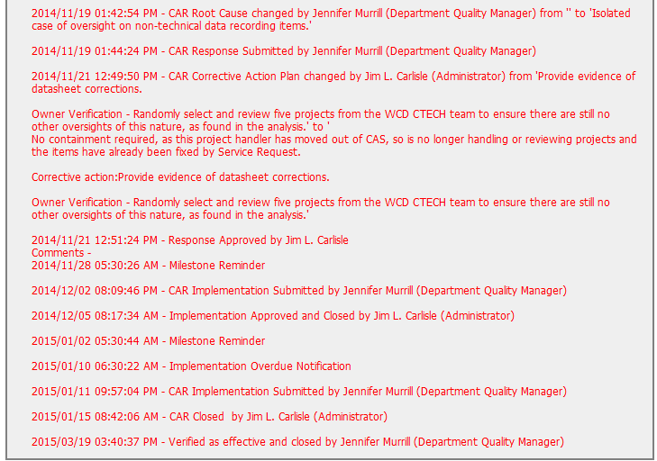
CAR 143914135 – History Study
This CAR owner is Kiran B. Patel, from the history, the CAR response and implementation are all submitted by Quality Manager, it is not a right way, suggest to add Quality manager or other person as owner assistant if owner didn’t have time to deal with this CAR.

Slide 16
CAR 143914135 – CBS Check
CBS Requirements | Excellent | Moderate | Need Improve | N/A
(C) Extensions are within requirement (<30 days, 3 or less) | X
(T) Most appropriate ‘category’, ‘type’, ‘geography’ are selected | X
(P) Facilitates the handling of disputed CARs |  |  |  | X
(T) Acts on CARs within required timeframe | X
(C) Analysis shows clear path to root cause and scope; stakeholders identified | X
(C) Root cause statement is succinct, reasonable, complete (Shows ‘N/A’ for observations) | X
(C) Corrective actions fix the objective evidence and other problems found; address entire root cause and scope. For observations, they do not go beyond fixing the objective evidence |  |  | X
(C) Milestones address containment & owner’s verification; completed per milestone expectations | X
(P) Verification per requirements | X
(L) Referenced communications are attached as needed | X
(C L) Evidence of communication for overdue/escalated CARs and other pertinent concerns |  |  | X
(P) Trains other CAR Champions |  |  |  | X

